Slide 1

London Frolics
Dom, Lydia, Allegra and Cynthujaa

Slide 2

User Stories
Drafted user stories based on four types of users:
Administrator
Blogger
Subscriber
Reader
As a Blogger, I want to add posts so I can share my experiences with others.
Notes:
DOM:
MOSCOW to prioritise the functionalities to design MVC model / database.
Line or two about what each of the users can do – and what functionalities.

Slide 3
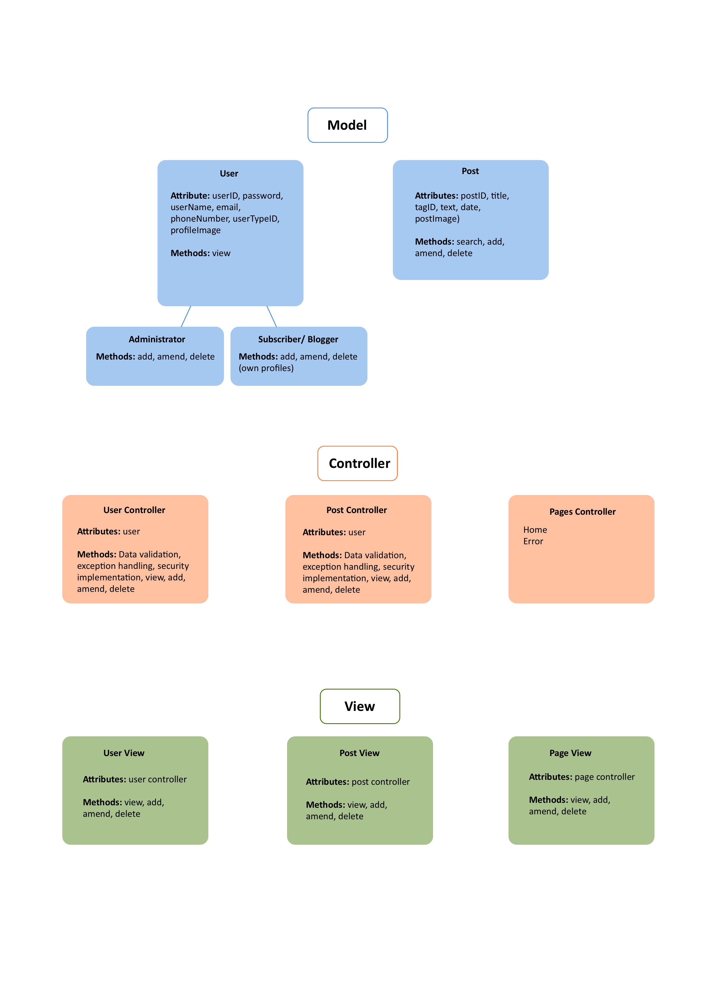
MVC model
Notes:
CYNTHUJAA:
Original design and expanded as progressed.
Add MVC model notes – controller, view, model.

Slide 4
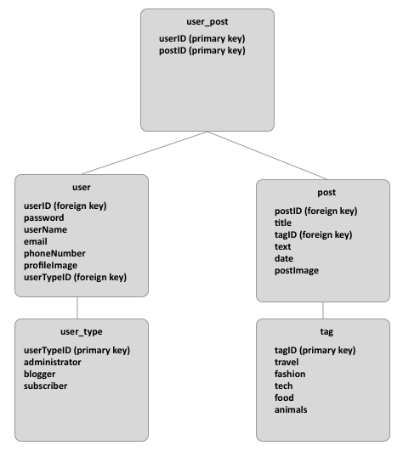
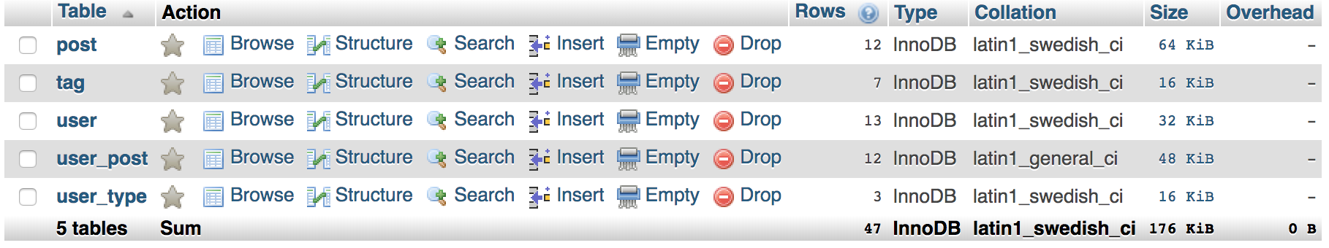
Database Design
Designed database – with post / user tables and normalisation included.
MySQL default functionalities:
Unique keys
Date - timestamp
Notes:
LYDIA
Designed based on MVC and sketched the foreign / primary keys.
TagName / UserType / Many-to-Many normalisation
Unique keys for username (prevents duplication)
Admin privileges
Stored procedures – search, update, add

Slide 5
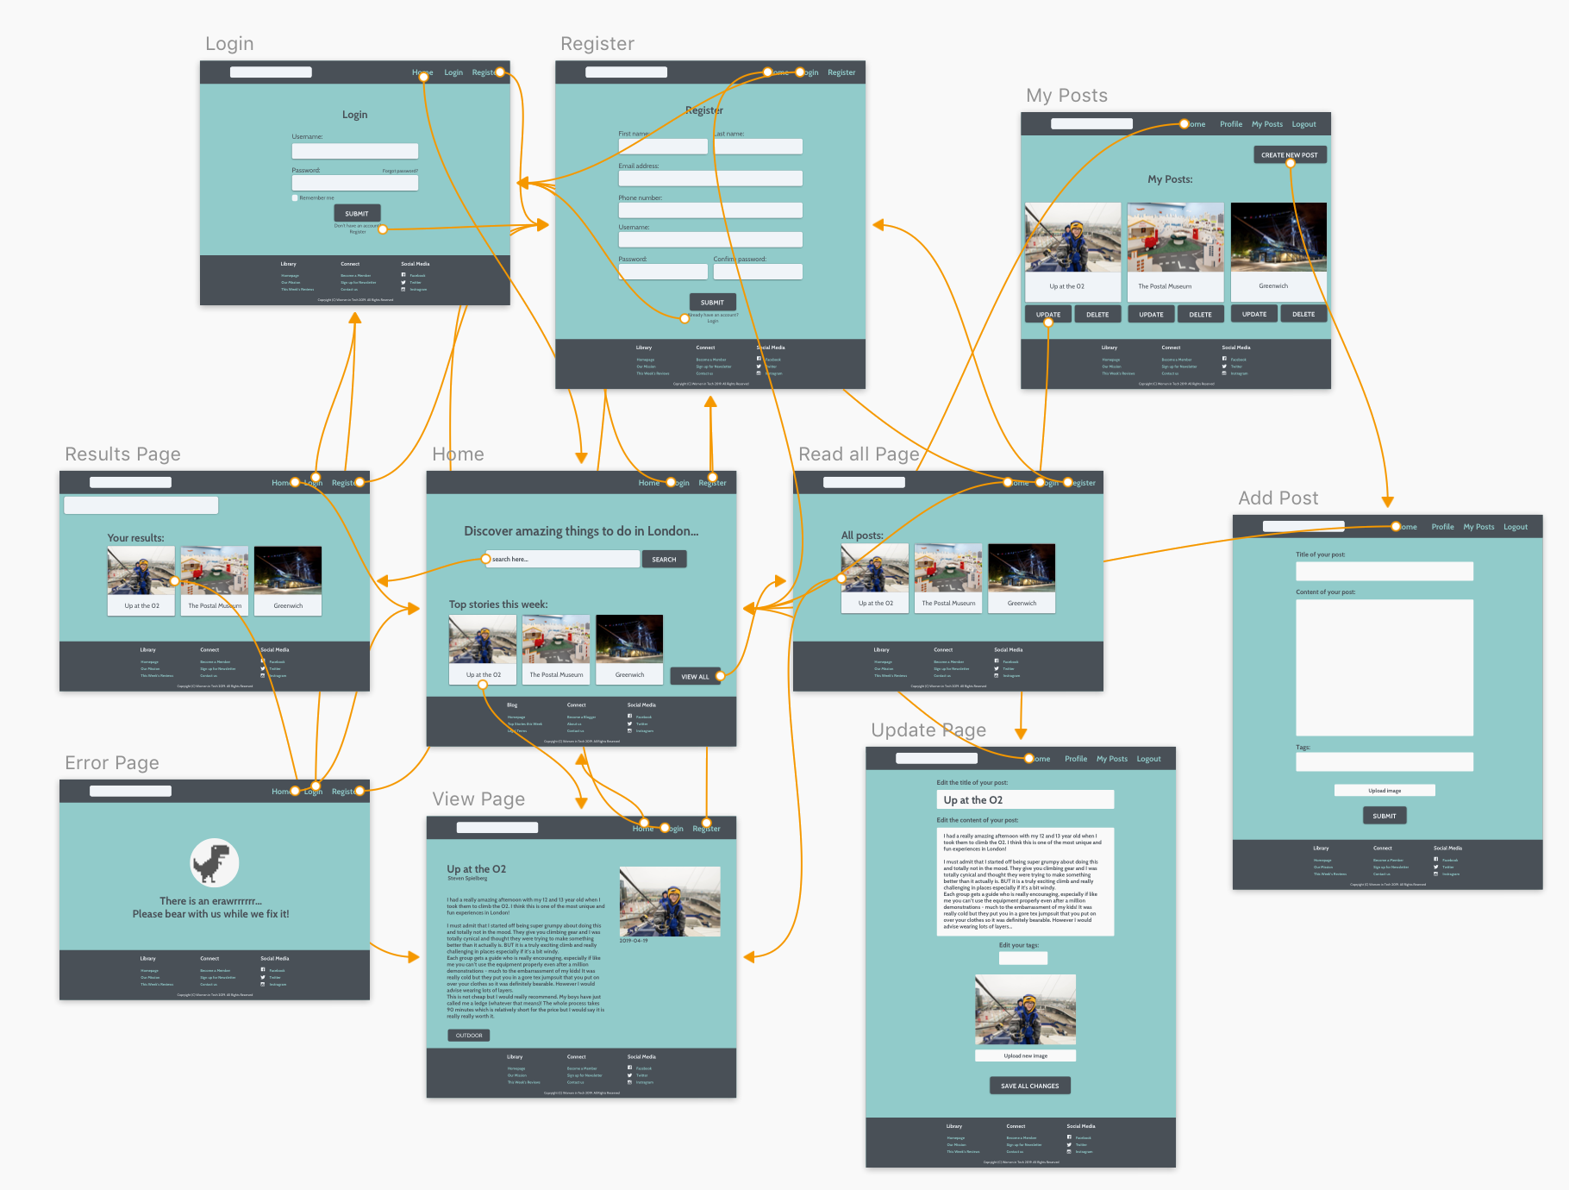
Wireframe
Notes:
ALLEGRA
Prototyping the connections
Started with drawings (to give an idea of what we wanted) before using Sketch.
Built upon this when coding as realised needed more pages / functionalities

Slide 6
Frolicking through our Website
Designed website based on wireframe and added the following functionalities:
Dynamic navigation bar
Registration form
Search function
Top stories
Sharing posts
My Posts
My Profile
Log in / Log out
Contact us
Responsive layout
Notes:
Homepage –top stories (three random posts), search function/results (%like%), viewAll posts, responsive layout (USER: READER) - DOM
Register – password confirmation, Regex password, unique username (USER:SUBSCRIBER/BLOGGER) - LYDIA
Log in – dynamic navigation bar, favourites - LYDIA
My Post - CYNTHUJAA
Add post – upload image, appears on viewAll page and My Posts
Update Post – reupload images, different tags
Delete – removes from database, MyPost
MyProfile – update information - ALLEGRA
Logo – redirects to homepage - ALLEGRA
Error page - ALLEGRA
Footer – contact us - ALLEGRA
Log out - ALLEGRA

Slide 7
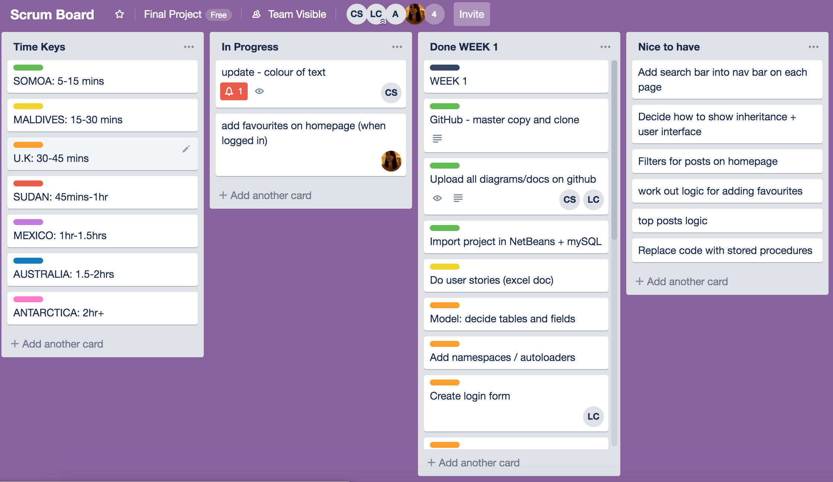
No Frolicking
Organisation
Weekend / weekday Hangouts
Daily standups
Final Hangout
Agile / Scrum – designated scrum master
Tools we used
Trello
Whatsapp
GitHub
Notes:
DOM

Slide 8

Any questions?

